Slide 1

COVID-19 XRAY Detector X
Using Image classification in machine learning
Supervisor : Dr. Mohamad Chaitou
Presented By : Ali Shhadi (11059) & Hadi Jaber (9623)

Slide 2
OVERVIEW
Introduction To Machine Learning .
Image Classification .
COVID-19 .
Used Model .
Model Data Set .
Data Pre-Processing .
Binary Classification .
Class Imbalance .
Model Result .
Introduction To TensorFlow .
TensorFlow Lite .
TensorFlow Converter .
Convert Keras To Quantized_TFLite .
Why Quantized ?
COVID-19 XRAY Detector X .
COVID-19 XRAY Detector X (Import Photo).
COVID-19 XRAY Detector X (Real-Time Camera).
References .
Thank You ☺ .

Slide 3
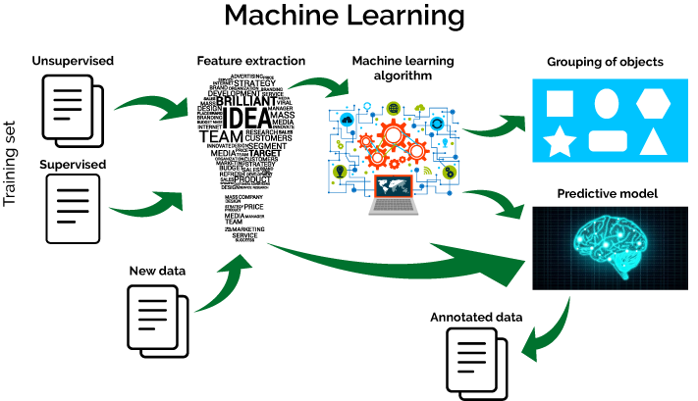
Introduction To Machine Learning
Machine learning is a subfield of artificial intelligence (AI). The goal of machine learning generally is to understand the structure of data and fit that data into models that can be understood and utilized by people.
Machine Learning mean making prediction based on data.
Feature extraction starts from an initial set of measured data and builds derived values (features) intended to be informative and non-redundant.
Supervised : Output are Known ( Labeled ).
Unsupervised : Output are Unknown ( Unlabeled ).

Slide 4
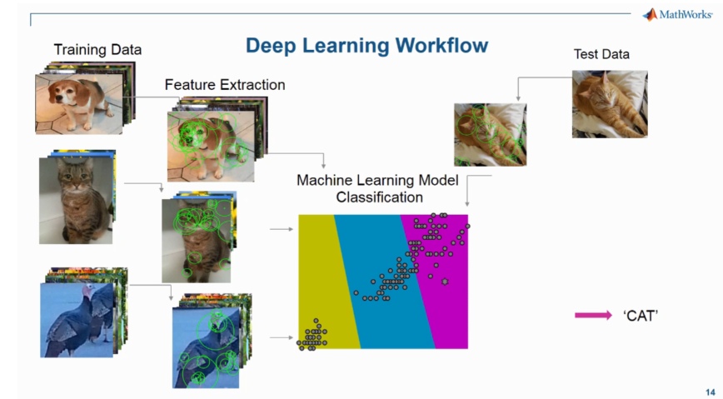
Image Classification
Image classification is a supervised learning problem: define a set of target classes (objects to identify in images), and train a model to recognize them using labeled example photos.

Slide 5
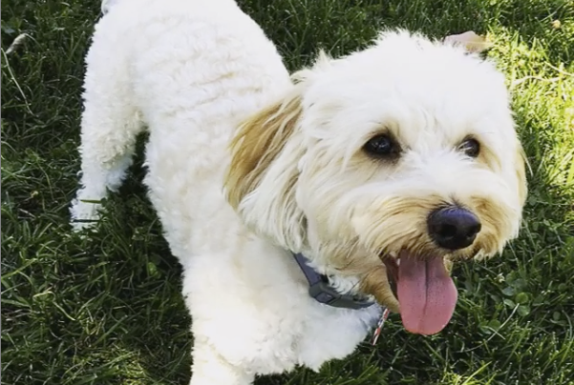
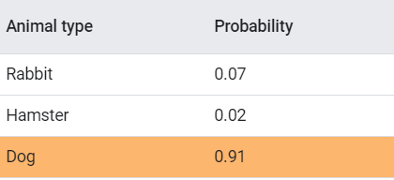
Image Classification
Image classification is a supervised learning problem: define a set of target classes (objects to identify in images), and train a model to recognize them using labeled example photos.
The task of predicting what an image represents is called image classification. An image classification model is trained to recognize various classes of images. For example, a model might be trained to recognize photos representing three different types of animals: rabbits, hamsters, and dogs.
When we subsequently provide a new image as input to the model, it will output the probabilities of the image representing each of the types of animal it was trained on. An example output might be as follows:
Based on the output, we can see that the classification model has predicted that the image has a high probability of representing a dog.

Slide 6

COVID-19
Since reverse transcription polymerase chain reaction (RT-PCR) test kits are in limited supply, there exists a need to explore alternative means of identifying and prioritizing suspected cases of COVID-19.
Moreover, large scale implementation of the COVID-19 tests which are extremely expensive cannot be afforded by many of the developing & underdeveloped countries hence if we can have some parallel diagnosis/testing procedures using Artificial Intelligence & Machine Learning and leveraging the historical data, it will be extremely helpful. This can also help in the process to select the ones to be tested primarily.
This can be done by classifying X-Ray images that are non expensive with high availability.

Slide 7
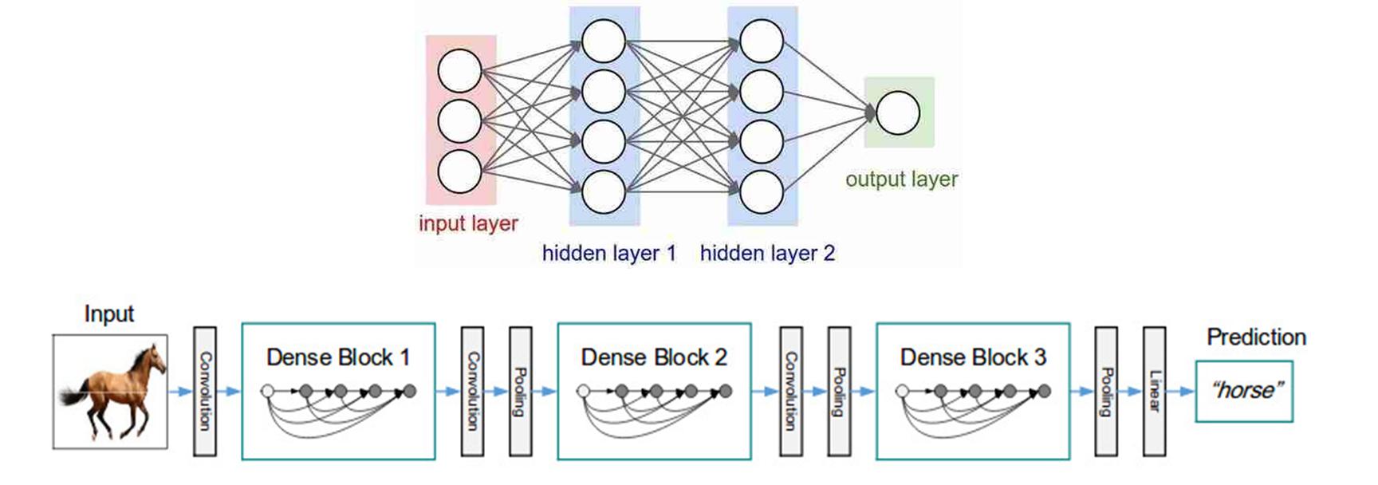
Used Model
A pretrained Keras model was used as the main model.
A deep convolutional neural network architecture was trained to perform binary classification COVID-19 positive or negative.
DenseNet architecture was used in the model. Which is faster and every feature has skip to all following features.

Slide 8
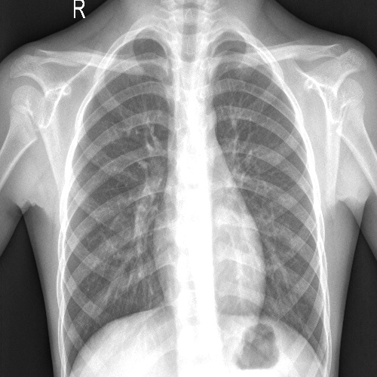
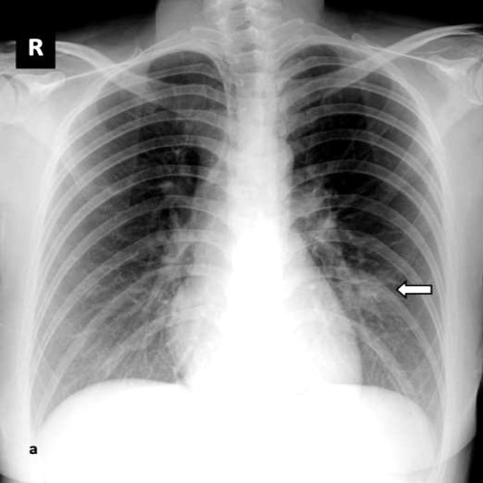
Model Data Set
For the purpose of this experiment, data was taken from two repositories:
https://github.com/ieee8023/covid-chestxray-dataset
https://www.kaggle.com/paultimothymooney/chest-xray-pneumonia
A sample of the data was taken which is a set of x-ray images some which are positive and some which are normal.
Normal
Positive

Slide 9
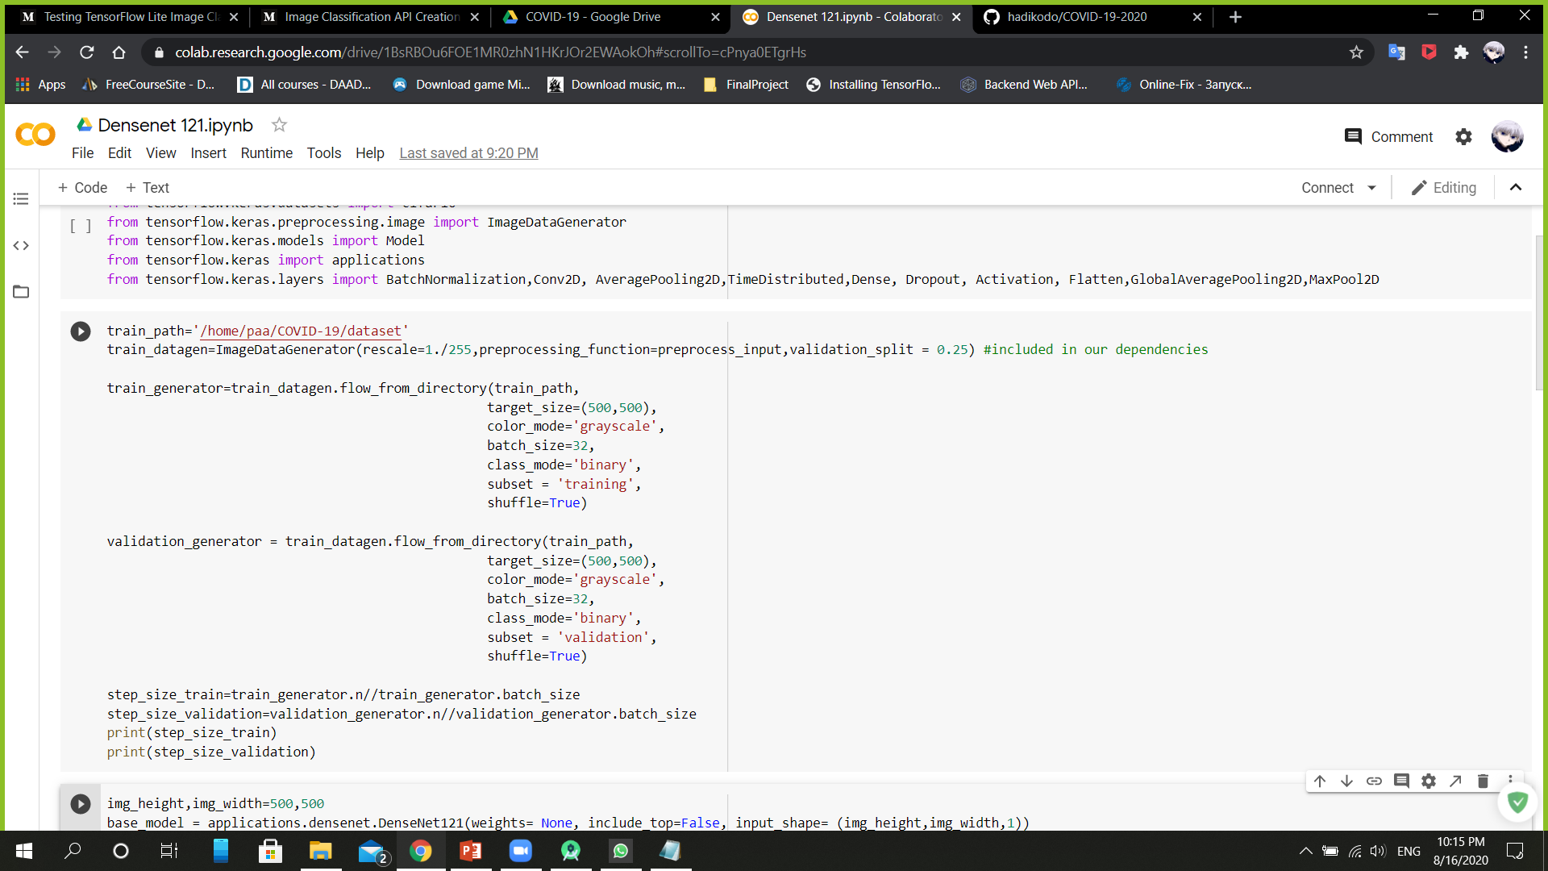
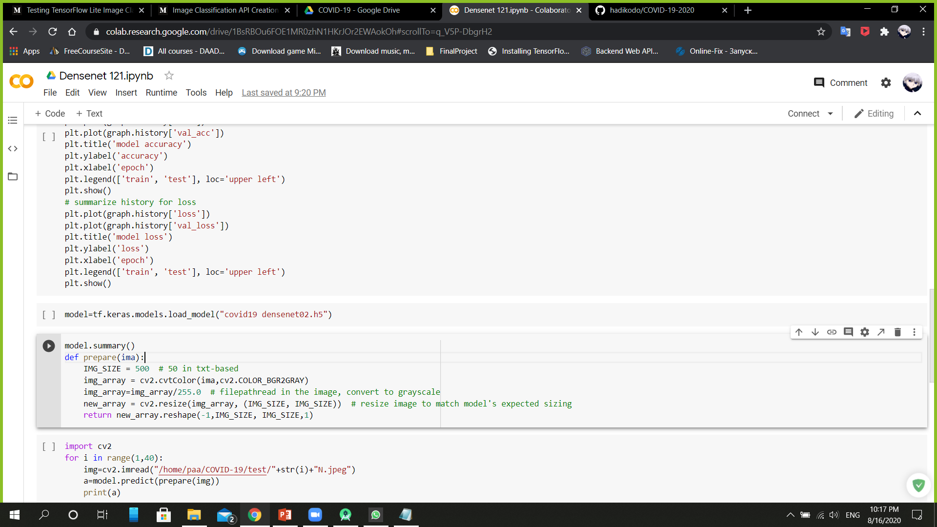
Data Pre-Processing
Prior to training, preprocessing was implemented on the images themselves. ImageDataGenerator (from tensorflow.keras) was employed to perform preprocessing of image batches prior to training.
The following transformations were applied to images: Images were resized to have the following shape: 500×500×3. By reducing the image size, the number of parameters in the neural network was decreased. images are normalized by scaling them so their pixel values are in the range [0, 1].

Slide 10
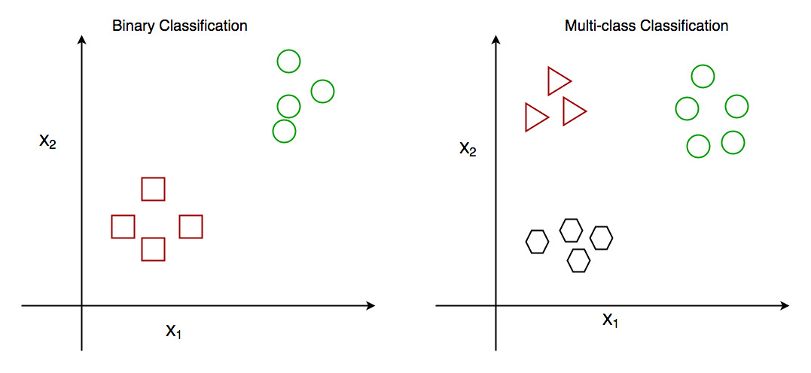
Binary Classification
We first considered a binary classification problem where the goal was to detect whether an X-ray shows evidence of COVID-19 infection.
The classifier was to assign X-ray images to either a non-COVID-19 class or a COVID-19 class.
A deep convolutional neural network architecture was trained to perform binary classification.

Slide 11
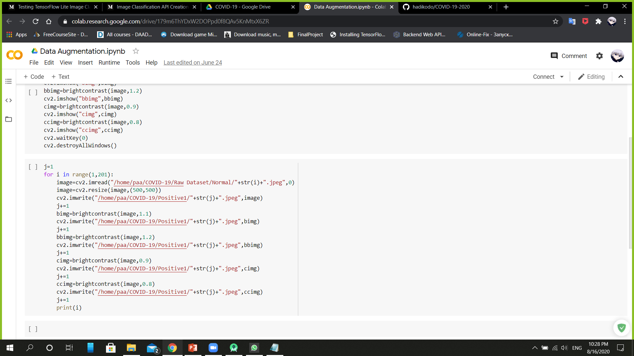
Class Imbalance
Due to the imbalance in severe COVID-19 cases ➔ imbalance of images .
Accuracy can be misleadingly high in classification problems when a class is underrepresented.
We apply Image Augmentation to overcome this issue. ( Increase the number of images by creating images of difference contrast/size from existing image )

Slide 12
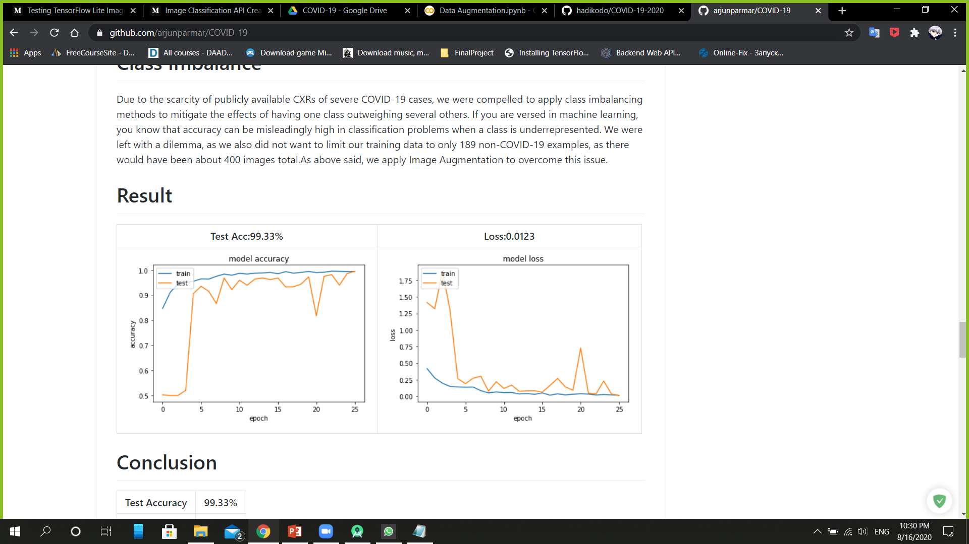
Model Result

Slide 13

Introduction To TensorFlow
TensorFlow provides a collection of workflows to develop and train models using Python, JavaScript, or Swift, and to easily deploy in the cloud, on-prem, in the browser, or on-device no matter what language you use.

Slide 14

TensorFlow Lite

Slide 15
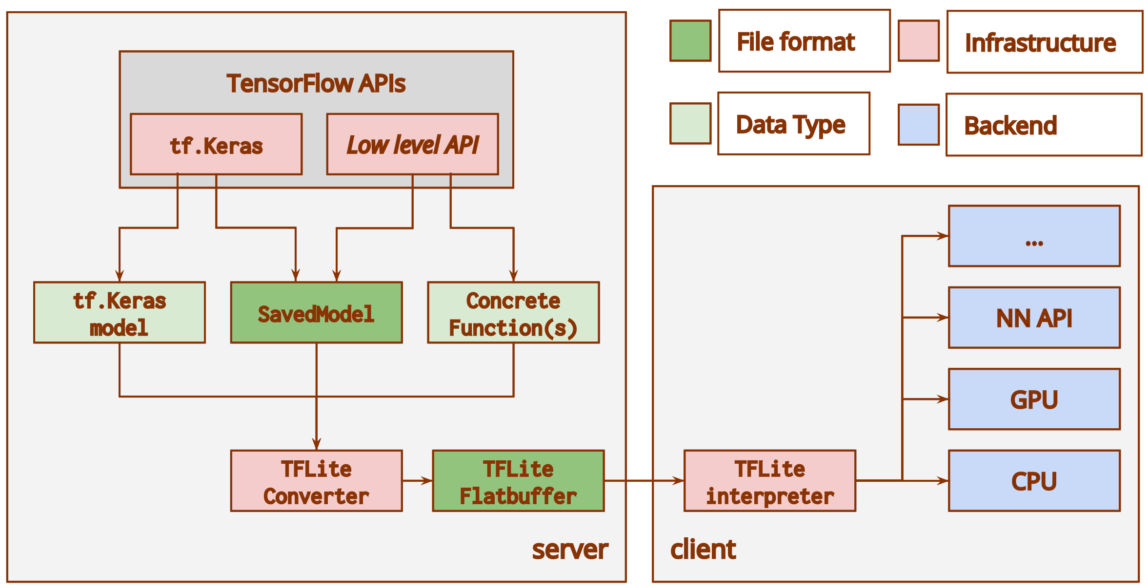
TensorFlow Converter

Slide 16
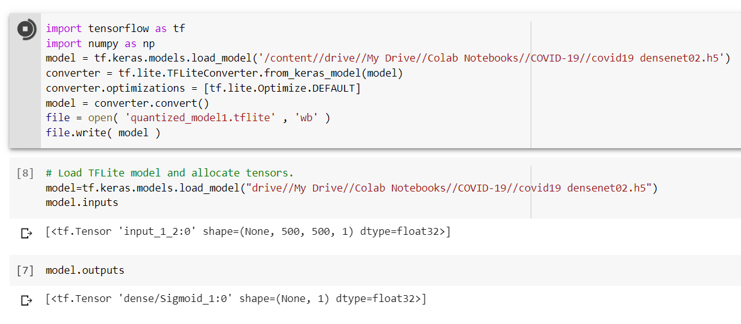
Converting Keras To Quantized_TFLite
We converted the pre-trained Keras model to quantized_tflite format.
This allows us to use the model in our android application.

Slide 17
Why Quantized ?
The simplest way to create a small model is to quantize the weights to 8 bits and quantize the inputs/activations "on-the-fly", during inference. This has latency benefits, but prioritizes size reduction.
This technique helps reduce both the memory requirement and computational cost of using neural networks at the cost of modest decrease in accuracy.

Slide 18
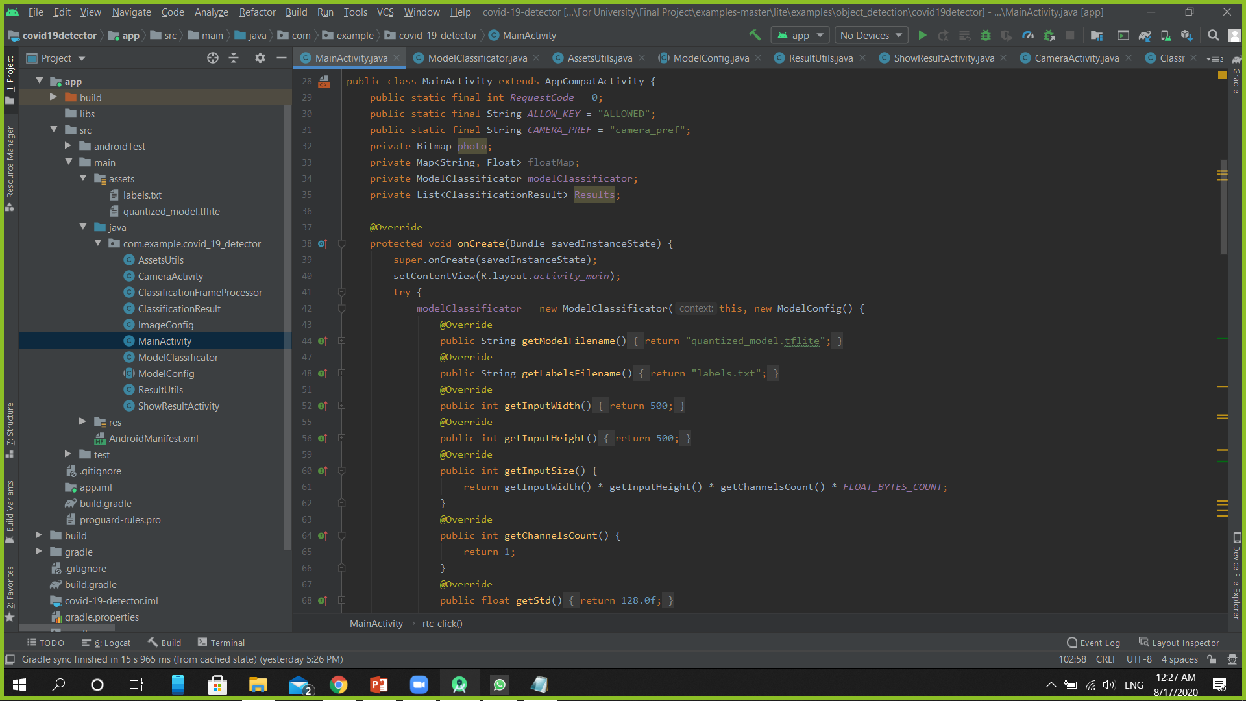

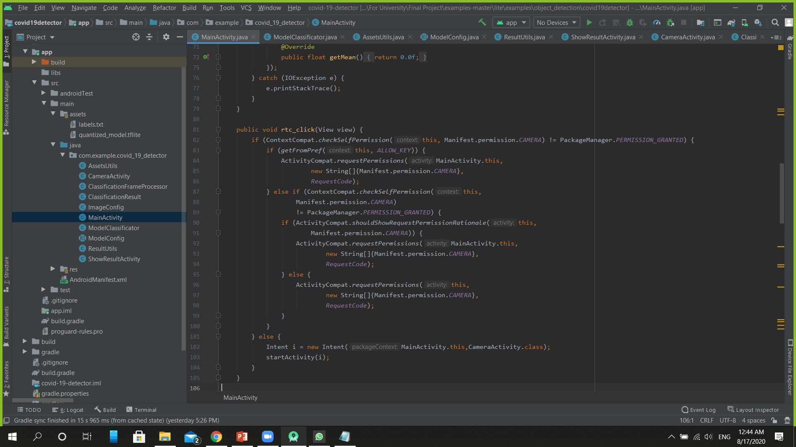
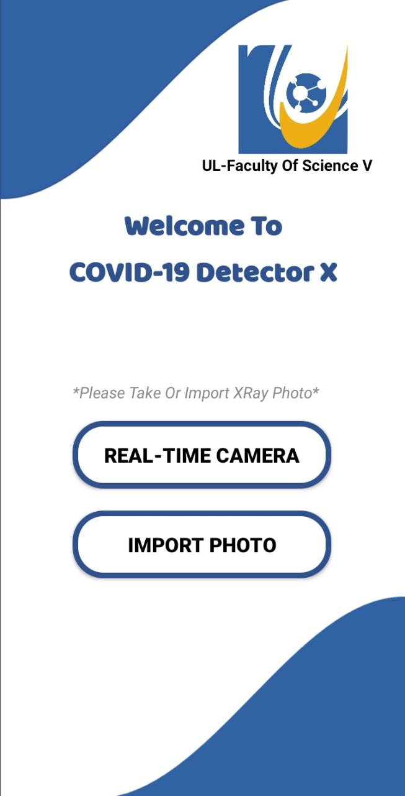
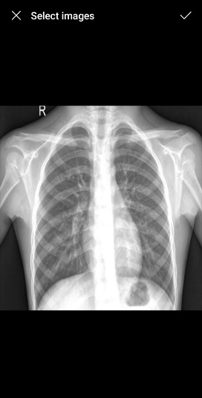
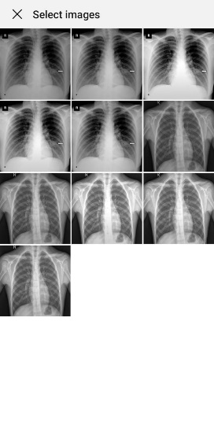
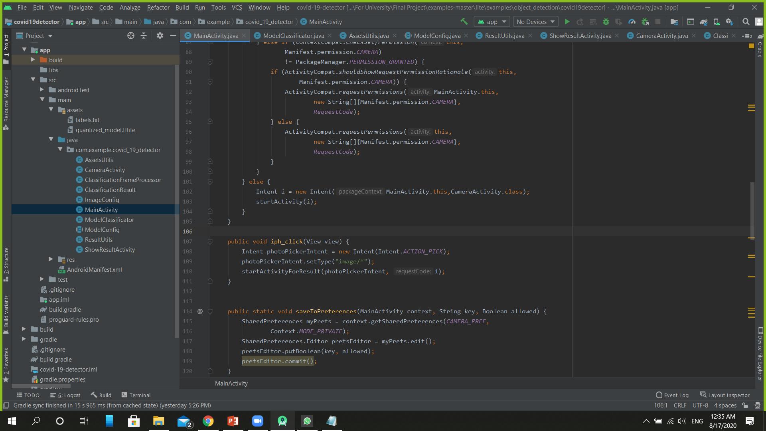
COVID-19 XRAY Detector X
On Click of Real-Time Camera
On Image Select
On Click of Import Photo

Slide 19
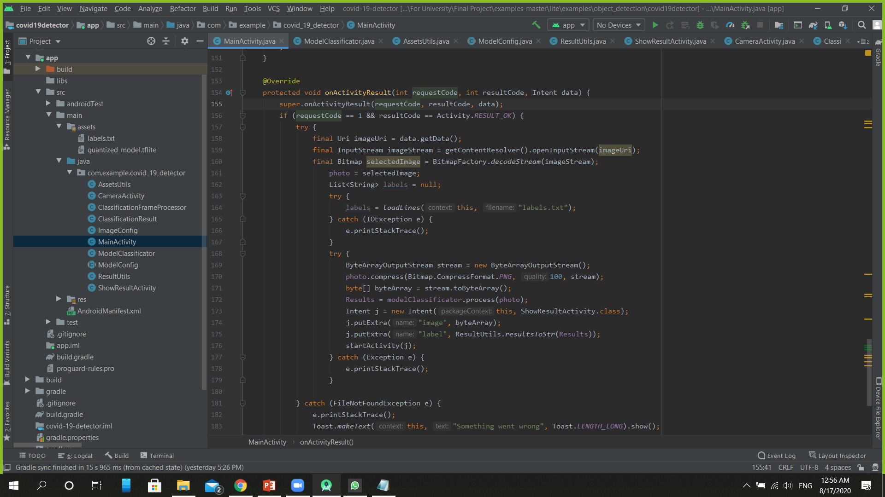
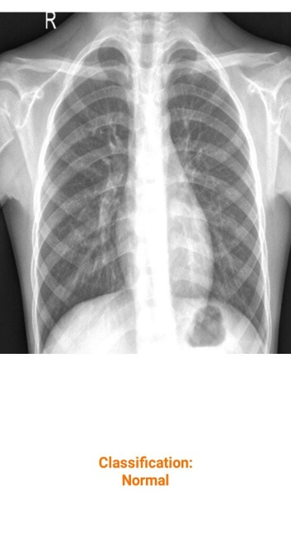
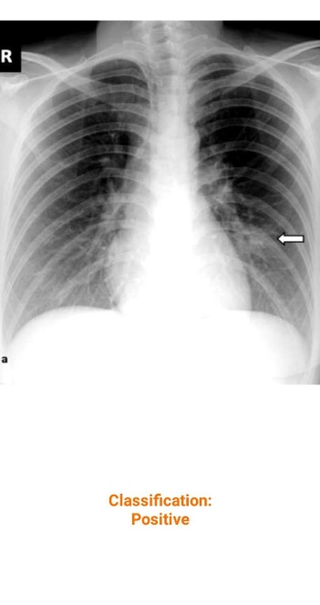
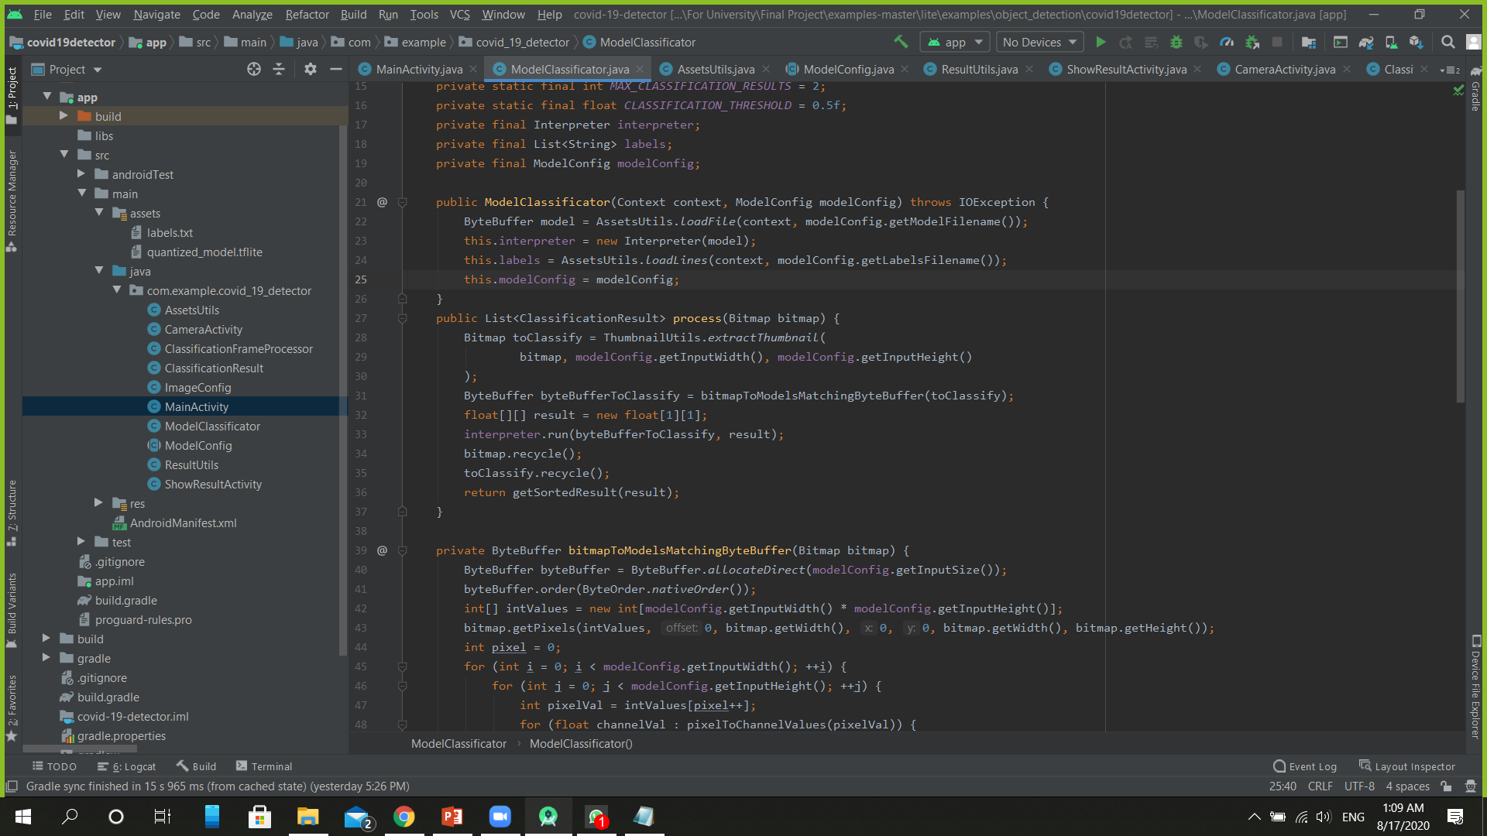
COVID-19 XRAY Detector X (Import Photo)
On Select Run This Code
After Selecting get the image and convert to Bitmap .
Compress the photo and get the result from the model by ModelClassificator class .
Start the result activity with the image and the result label .
Getting The Result
Result
OR
Convert image into 500x500 Byte Buffer .
Get the result from model through interpreter .

Slide 20
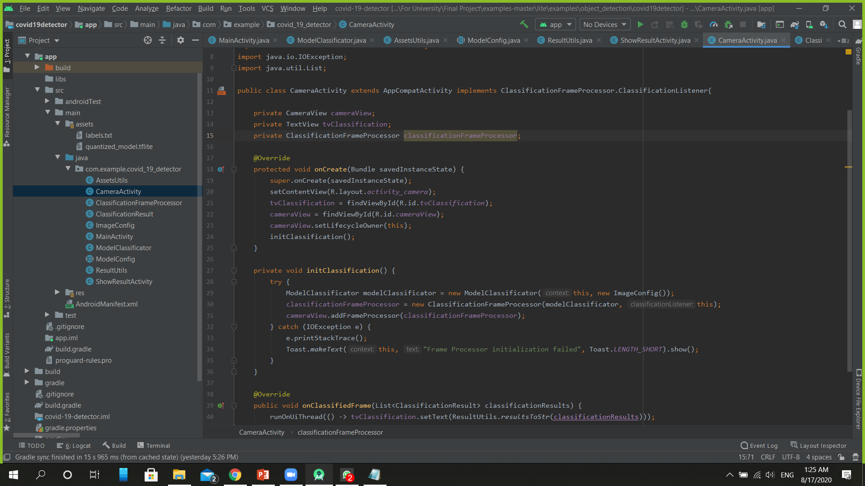
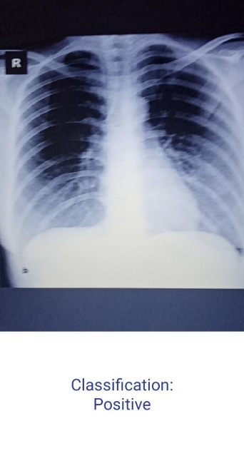
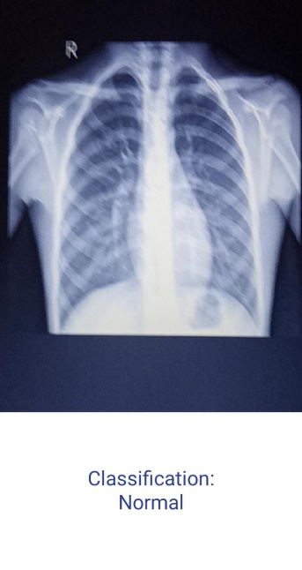
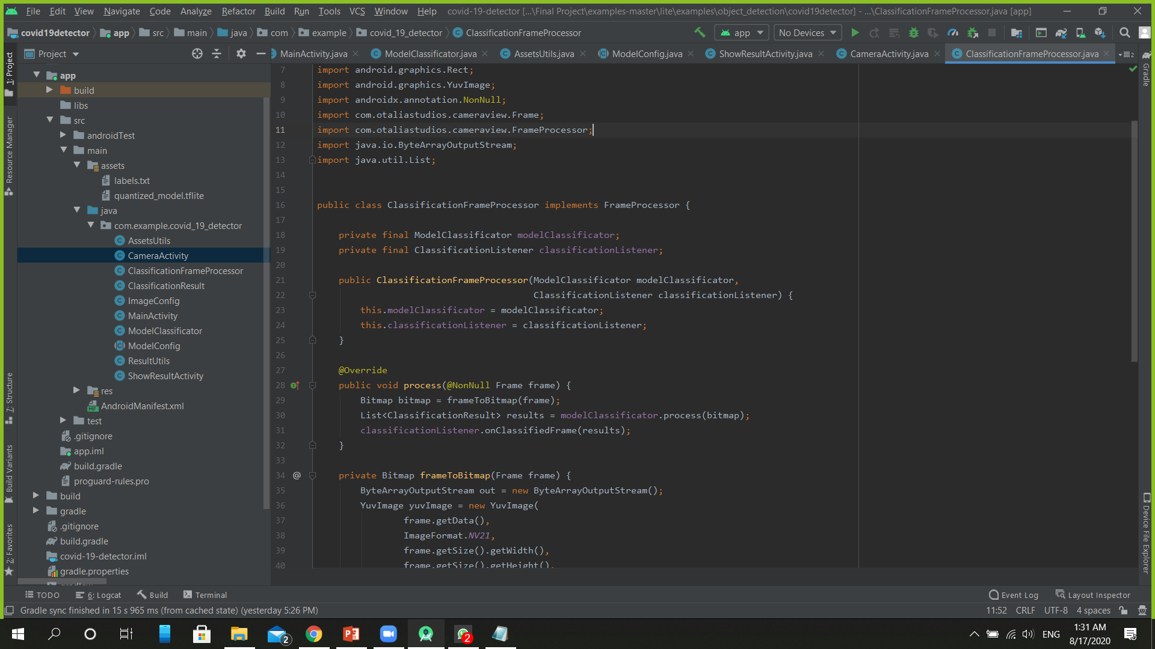
COVID-19 XRAY Detector X (Real-Time Camera)
Camera Working
Take instance of ModelClassificator to access the model and the labels .
Take instance of ClassificationFrameProcessor .
Take Bitmap of Frame and get result from ModelClassificator instance .
Display Result .
Result
OR

Slide 21
References
https://www.pyimagesearch.com/2020/03/16/detecting-covid-19-in-x-ray-images-with-keras-tensorflow-and-deep-learning/
https://github.com/frogermcs/TFLite-Tester/tree/558d0dca39df476afbeb8dcd1689c174d6416439
https://medium.com/edureka/tensorflow-image-classification-19b63b7bfd95
https://medium.com/towards-artificial-intelligence/testing-tensorflow-lite-image-classification-model-e9c0100d8de3
https://thinkmobile.dev/automate-testing-of-tensorflow-lite-model-implementation/
https://blog.tensorflow.org/2018/03/using-tensorflow-lite-on-android.html
https://www.tensorflow.org
https://www.tensorflow.org/lite/
https://github.com/lindawangg/COVID-Net
https://www.tensorflow.org/lite/performance/post_training_quantization
https://github.com/arjunparmar/COVID-19
https://www.digitalocean.com/community/tutorials/an-introduction-to-machine-learning
https://miro.medium.com/max/711/1*bCiubUgX_x2ScZ9xaGVbGw.png
https://developers.google.com/machine-learning/practica/image-classification
https://www.mathworks.com/matlabcentral/mlc-downloads/downloads/submissions/58320/versions/8/screenshot.png

Slide 22







❤ Thank You ❤

